Slide 1
City of Laguna Beach Investment Status Report With Guest Financial Expert Bill Blackwill, Managing Director Stifel Investment Services
Monday November 29, 2021 10:30am
Zoom Instructions
Join Zoom Meeting
One tap mobile: | US: +16699009128,,93343350518# or +12532158782,,93343350518#
Meeting URL: | https://lagunabeachcity.zoom.us/j/93343350518
Meeting ID: | 933 4335 0518
Join by Telephone
For higher quality, dial a number based on your current location.
Dial: | US: +1 669 900 9128 or +1 253 215 8782 or +1 346 248 7799 or +1 312 626 6799 or +1 646 558 8656 or +1 301 715 8592
Meeting ID: | 933 4335 0518

Slide 2
City of Laguna Beach Investment Status Report September 30, 2021 With Guest Financial Expert Bill Blackwill, Managing Director Stifel Investment Services
Monday November 29, 2021 10:30am
Zoom Instructions
Agenda
Introductions
Economic update – Bill Blackwill
Laguna Beach Portfolio Update
2021 Investment Strategy and Policy Discussion
Laura Parisi, CPA, CCMT Victoria H. McIntosh, CPA
City Treasurer Deputy City Treasurer
lparisi@lagunabeachcity.net
(949)497-0327 office (part-time) (949)677-0327 cell

Slide 3
Economic Update Bill Blackwill, Managing Director Stifel Investment Services

Slide 4
The Fed
Letting Inflation run hot
Will it be transitory or not?
They have begun to taper asset purchases
They have said they are likely to raise rates in 2022

Slide 5
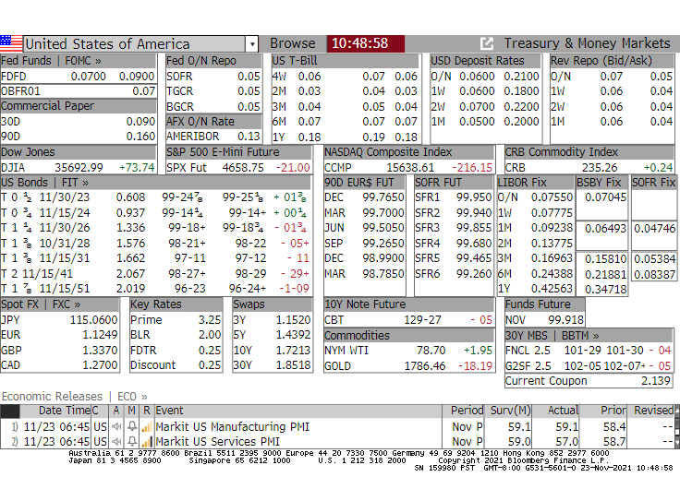
Current Rates and Market Information

Slide 6
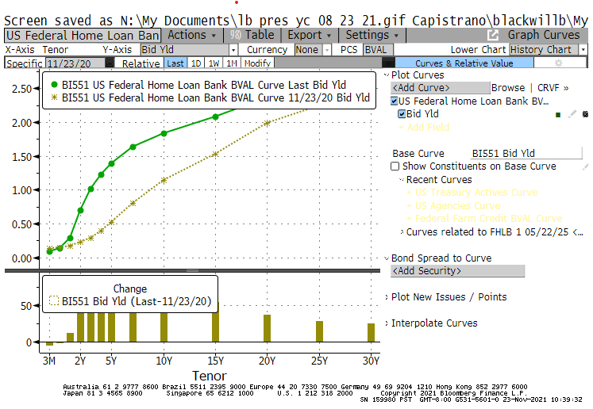
Yield Curve Now vs 1yr ago

Slide 7
Questions to Ask
Will the Economic Recovery Continue?
What will happen with Covid?
Will Inflation be transitory?
Will supply chain issues improve?
Will people go back to work?

Slide 8
Stifel’s Forecast
We expect higher short-term rates
We expect the 2yr Treasury to be 0.95 by the end of 2022 but we only expect the 10yr Treasury to be 1.75
They are currently 0.61 and 1.66
Our Strategist has concerns over just how transitory inflation will be

Slide 9
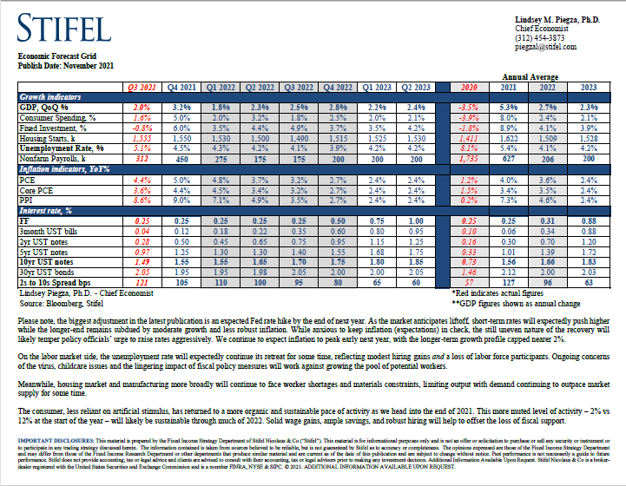
Economic and Rate Forecast

Slide 10
Laguna Beach Portfolio Update Emerging from Investing During the Pandemic
At February 29, 2020
At September 30, 2021
$105.5 Million Dollars
Average yield 1.99%.
Benchmark 2-year T-Bill was 0.89% and declining to 0.49% at 3/11/20.
Effective duration is less than stated duration and estimated at 1.44 years.
Highly rated securities.
GAAP: Unaudited unrealized gain $851,000.
$105.7 Million Dollars
Average yield 0.98%.
Benchmark 2-year T-Bill was 0.28%
Effective duration is less than stated duration and estimated at 2.46 years.
Highly rated securities.
GAAP: Unaudited unrealized loss $54,000.

Slide 11
City of Laguna Beach 2021 Investment Strategy and Policy Discussion
2021 ESG Investing - Fossil Fuel Divestment:
In 2017 the Ad Hoc Committee encouraged and discouraged certain investment types including fossil fuels while remaining silent in the Investment Policy to allow maximum choices in changing markets.
The 2017 strategy has worked well and there are no direct fossil fuel investments in today’s portfolio.
There is not a requirement for banks to disclose fossil fuel clients or their relationships. The fossil fuel category is broad and infinitely complex. Best efforts would need to be made to standardize the measurement and definition fossil fuel companies. Assistance would be welcomed.
I could not find a major bank on the internet that did not have some type of ESG concern. There is a need to balance the stability, breath of services and other factors as identified by the community with a banks ESG policies.

Slide 12
City of Laguna Beach 2022 Investment Strategy and Policy Discussion
2022 Recommended Strategies:
Barbell maturities to increase yield in rising rate environment.
Continue daily cash flow forecasting and analysis.
In a rising rate environment, invest outside of LAIF on the short end.
No new California municipal investment legislation in 2021.
Any policy restrictions should be carefully considered because the impact in a volatile political environment is uncertain.
Encourage selection of ESG sensitive investments and discourage investment in fossil fuel companies. Regularly but no less than annually consider the need to add a restriction to the Investment Policy.

