Slide 1
City of Laguna Beach Investment Status Report Q1 2020 With Guest Financial Expert Bill Blackwill, Managing Director Stifel Investment Services
Thursday, March 12, 2020; 4:30pm
505 Forest Avenue, Laguna Beach
Conference Room C
Agenda
Economic update Coronavirus Impact – Bill Blackwill
Portfolio attributes
Investment Policy direction
Unrealized gains
Investing in the future
Refinancing assessment district debt
Laura Parisi, CPA, CCMT
City Treasurer

Slide 2
Economic Update Bill Blackwill, Managing Director Stifel Investment Services Hardcopy slides will be available at the meeting.

Slide 3
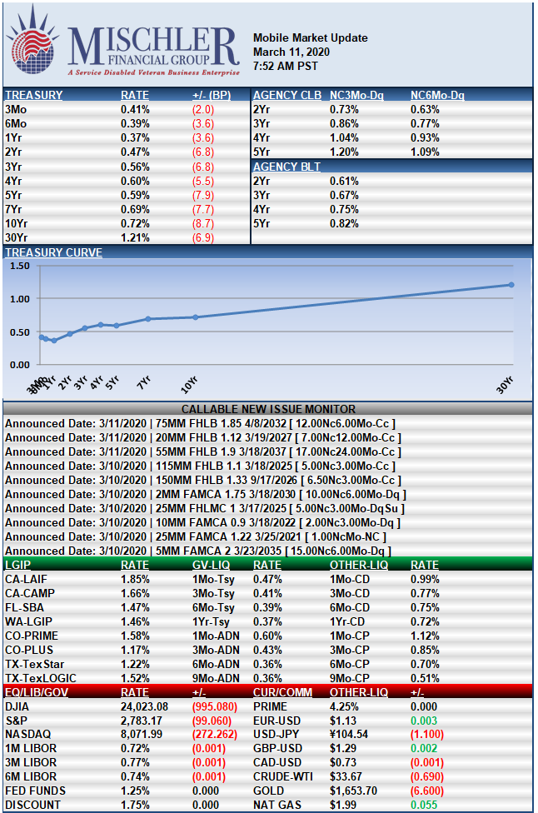

Slide 4
Portfolio Attributes At February 29, 2020
$105.5 Million Dollars at February 29, 2020.
Average yield 1.99%.
Benchmark 2-year T-Bill was 0.89% and declining to 0.49% at 3/11/20.
Effective duration is less than stated duration and estimated at 1.44 years.
Highly rated securities.

Slide 5
Investment Policy Direction
INVESTMENT PHILOSOPHY:
The City’s investment philosophy is to invest conservatively to minimize risk. Investments shall be made in a manner consistent with the Prudent Investor Standard for trustees of local government monies, as described in Government Code section 53600.3, which states as follows:
When investing, reinvesting, purchasing, acquiring, exchanging, selling, or managing public funds, a trustee shall act with care, skill, prudence and diligence under the circumstances then prevailing, including, but not limited to, the general economic conditions and the anticipated needs of the agency, that a prudent person acting in a like capacity and familiarity with those matters would use in the conduct of funds of a like character and with like aims, to safeguard the principal and maintain the liquidity needs of the agency.
OBJECTIVE:
The authority governing investments for municipal governments is set forth in Government Code sections 53600 et seq. The primary objectives of investment activities, in order of priority, are:
SAFETY:
Safety of principal is the foremost objective of the investment program. The investment of City funds shall be undertaken to seek to ensure the preservation of capital in the overall portfolio. To attain this objective, the City shall diversify its investments by investing funds among a variety of securities offering independent returns and from various financial institutions.
LIQUIDITY:
The investment portfolio will remain sufficiently liquid to enable the City to meet the operating requirements that are reasonably anticipated.
YIELD:
The City’s investment portfolio shall be designed with the objective of attaining a benchmark rate of return throughout budgetary and economic cycles, commensurate with the City’s investment risk constraints and the cash flow characteristics of the portfolio. The benchmark rate of return is defined in paragraph 17.1.

Slide 6
Unrealized Gains at March 10, 2020 totaled $851,000
Is it time to change the buy and hold philosophy to realize gains, eliminate potential credit quality risk, BUT
Low reinvestment options excluding LAIF which is expected to decline rapidly.

Slide 7
Investing in the future
Low rate environment with extreme volatility.
Increased risk may increase returns as suggested by Chandler Asset Management.
Modify benchmark rate of return?
Add treasuries to reduce volatility?
Impose limitations on callable bonds?

Slide 8
Refinancing Assessment District Debt
Lower rates for homeowners
City financed?
Combined refunding either public or private?
Do Nothing.

