Slide 1
City of Laguna Beach Investment Status Report Q2 2019 With Guest Financial Expert Bill Blackwill, Managing Director Stifel Investment Services
Monday June 10, 2019; 4:30 to 6:00; Laguna Beach City Hall, Conference Room A
Attendees: Karl Koski, Public Representative; Bob Whalen, Mayor; Sue Kempf, Councilmember,
John Pietig, City Manager; Gavin Curran, Director of Administration; Bill Blackwill, Managing Director Stifel Investment Services
Agenda
Introductions
Public Comment
Review of Consensus Discussion from Annual Investment Status Report Meeting, November 6, 2018
Impact of lack of official city General Ledger on mandatory investment reporting
Report on investment inventory at May 31, 2019 (Parisi)
The inverted yield curve and investing (Blackwill)
Investment Status Committee, Ad Hoc composition revisited
2019 Investment Agreed Upon Procedures
Laura Parisi, CPA, CCMT
City Treasurer

Slide 2
Committee Consensus and Discussion From November 6, 2018
Consensus Recommendations
Exclude unrealized losses from consideration when selecting investments.
Achieving budgeted investment income is a secondary consideration when selecting securities. The adopted budget includes only realized investment income.
The Investment Policy adequately states the intended policies of Safety, Liquidity and Yield. Socially Responsible Investing is desirable but a lower priority.
Refine cash flows when possible. Continuously search for and encourage further improvement in documenting the timing of forecasted disbursements. Identify opportunities to prepare monthly cash flow estimates based on City Council approved budgets.
Further discussion on Ad Hoc committee that has been working well. Expand role to include the selection of the firm that will test compliance with the City Council’s Investment Policy.
Modify the 2019 Investment Policy to require that a review to test compliance be performed every year and remove swaps from the prohibited security list.
Discussion
When financially advantageous to the overall portfolio, make it acceptable to sell some investments, even at a loss.

Slide 3
Why are there temporary Investment Inventory Reports from December 2018 to present
The investment inventory and related income is reconciled daily. Operating cash accounts (Bank of America) and related fund balances are obtained from the General Ledger that was last published November 2018.
The investment inventory has been published as a temporary report on investments and placed on the City website for public viewing.

Slide 4
Investment Inventory (excluding cash) Report At May 31, 2019
 |  | 5/31/2019 |  | 5/31/2018
LAIF | $ | 17,054 | $ | 15,191 |  | 12%
Market securities |  | 96,799 |  | 94,078 |  | 3%
AD bond proceeds |  | 36 |  | 190 |  | -81%
 | $ | 113,889 | $ | 109,459 |  | 4%

Slide 5
Investment Inventory (excluding cash) Report At May 31, 2019

Slide 6
Bill Blackwill, Managing Director Stifel Investment Services
The inverted yield curve and municipal investing

Slide 7
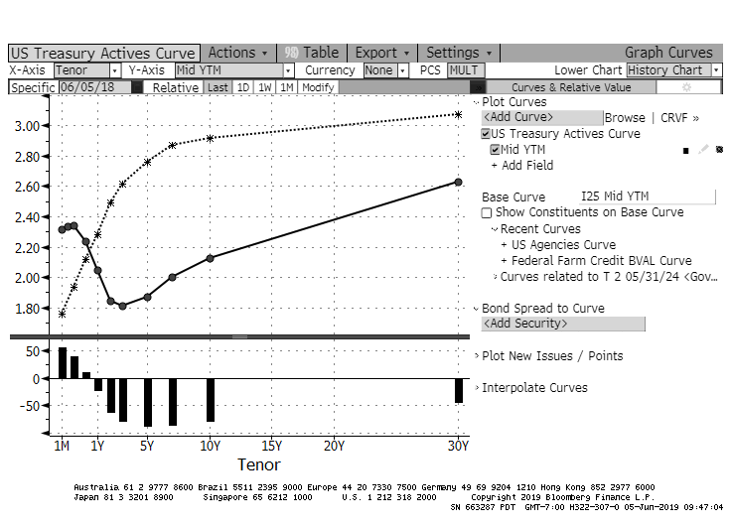

Slide 8
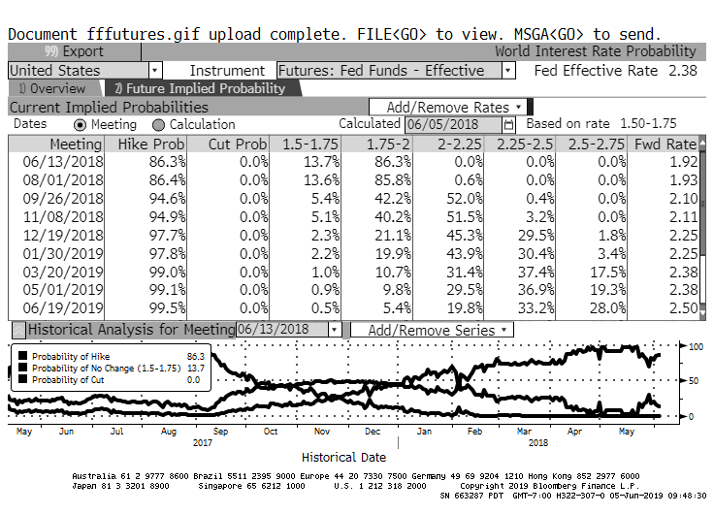

Slide 9
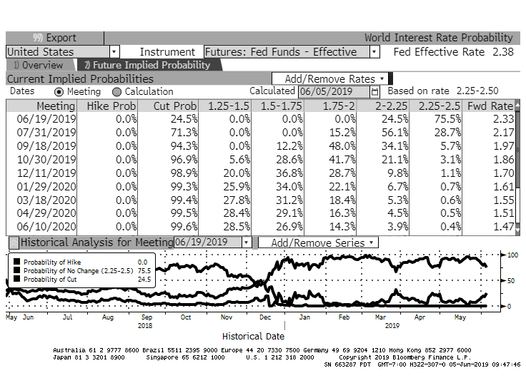

Slide 10
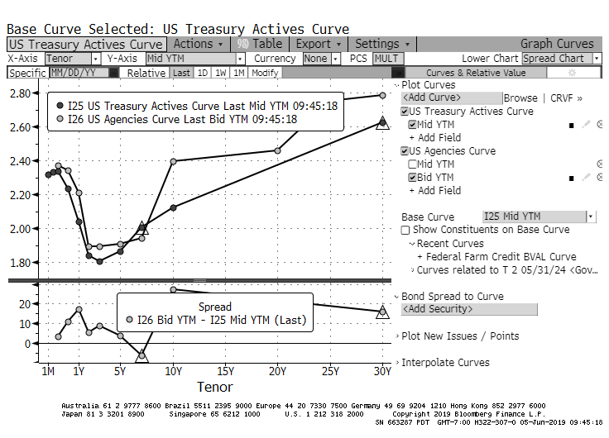

Slide 11
Additional Considerations
Should this Ad Hoc committee be expanded?
Select auditor to perform 2019 tests for compliance with the 2019 Investment Policy
Process is guided by Laguna Beach Municipal Code 2.30.030 Purchasing procedures (b) Informal Bid Procedure
2018 Bids
Vavrinek, Trine, Day & Co. LLP $3,100 - selected
White, Nelson Diehl, Evans, LLP $3,200 (firm unilaterally modified the procedures that were agreed to by the Director of Administration and City Treasurer)

