Slide 1
City of Laguna Beach Investment Status Report With Guest Financial Expert Bill Blackwill, Managing Director Stifel Investment Services
Thursday May 8, 2018 3:30 to 4:50pm; Laguna Beach City Hall, Conference Room A
Attendees: Karl Koski, Public Representative; Bob Whalen, Councilmember; John Pietig, City Manager; Gavin
Curran, Director of Finance; Vicki McIntosh, CPA, Deputy City Treasurer
Agenda
Status of investments, March 31, 2018 2
Investing in a rising rate environment, Bill Blackwill 7
Progress Report and Socially Responsible Investing Discussion 16
Committee Consensus and Discussion 17
Laura Parisi, CPA, CCMT
City Treasurer

Slide 2
Investment Priorities
Top priority is Safety of taxpayer dollars achieved through internal controls, portfolio diversification, experienced brokers and custodial bank. Reliable monthly reporting, semi-annual outside auditor review, annual audit and this committee provided guidance.
Liquidity in a rising rate environment is critical. Fewer to no bond calls.
Yield increases as positions mature and can be invested at the higher market rates. Cash flow management is key.

Slide 3
Safety - $102,197,000 at March 31, 2018 Highly Rated and Diversified Investments

Slide 4
Liquidity and Cash Flow
LAIF Target During 2018 Dry Period, on April 25, 2018
 | (1) | (2) |  | (3) |  | (4) |  | (5) |  | (6) |  | (7) |  | (8) |  | (9)
 | 2017 Cash Flow Working Paper |  |  |  |  |  |  |  |  |  |  |  |  |  |  |  |  | April 25,
 |  | Warrants |  |  |  |  |  |  |  | Inflow |  | Minimum |  |  |  |  |  | 2018
 | Deposits | Payroll |  | General |  | Other |  | Maturities |  | (Outflow) |  | Requirements |  | Contingency |  | Target LAIF |  | LAIF
May-17 | $ 8,589 | $ 2,088 |  | $ 4,732 |  |  |  |  |  | $ 1,769 |  | $ 10,542 |  | $ 4,000 |  | $ 14,542 |  | $ 16,300
Jun-17 | 2,922 | 2,343 |  | 4,865 |  |  |  | 1,500 |  | (2,786) |  | 12,311 |  | 4,000 |  | 16,311
Jul-17 | 6,440 | 2,690 |  | 7,149 |  |  |  | 1,000 |  | (2,399) |  | 9,525 |  | 4,000 |  | 13,525
Aug-17 | 4,053 | 1,337 |  | 6,265 |  |  |  |  |  | (3,549) |  | 7,126 |  | 4,000 |  | 11,126
Sep-17 | 3,230 | 2,421 |  | 3,583 |  | - |  |  |  | (2,774) |  | 3,577 |  | 4,000 |  | 7,577
Oct-17 | 3,864 | 2,428 |  | 4,987 |  |  |  | 2,748 |  | (803) |  | 803 |  | 3,000 |  | 3,803
Totals | $ 29,098 | $ 13,307 |  | $ 31,581 |  | $ - |  | $ 5,248 |  | $ (10,542)

Slide 6
Yield – Realized Interest Income and Unrealized Loss
Unrealized Loss
Rising interest rates create unrealized losses until investments mature.
Unrealized gains and losses must be recorded for financial statements to comply with GAAP. A monthly calculation is provided to City Manager. Annually calculated by outside auditor and recorded in the audited CAFR. Staff records the annual auditor calculation in the City books.
None of the loss will be realized if investments are held to maturity.
Good news is unrealized losses have NEVER been realized in Laguna Beach due to sufficient liquidity.

Slide 7
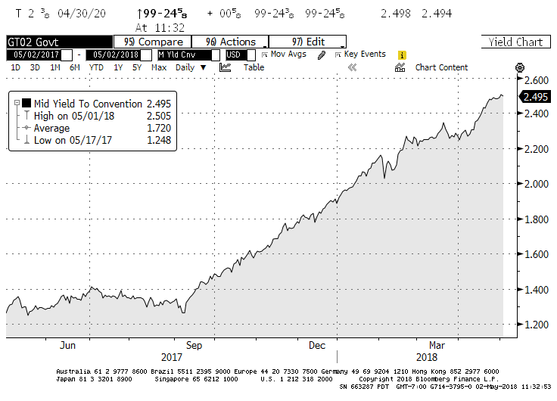

Slide 8
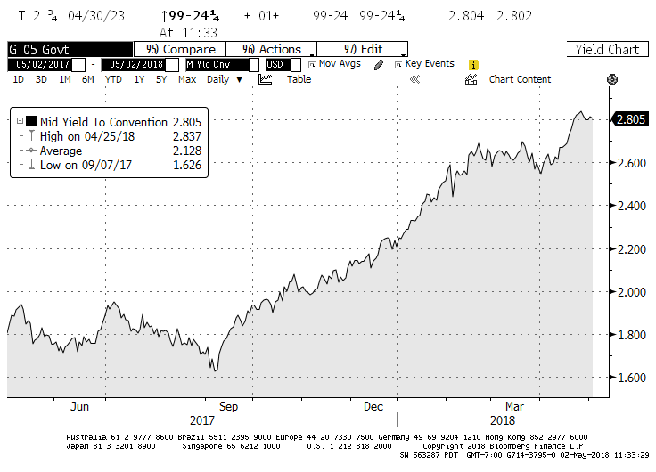

Slide 9
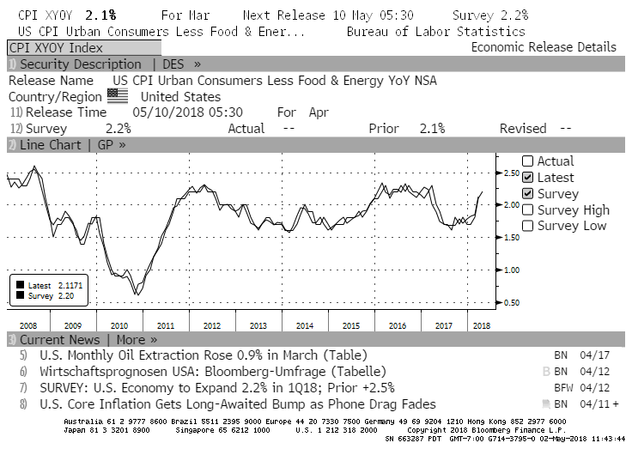

Slide 10
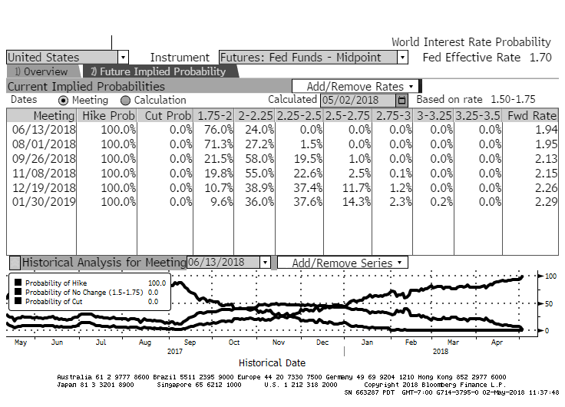

Slide 11
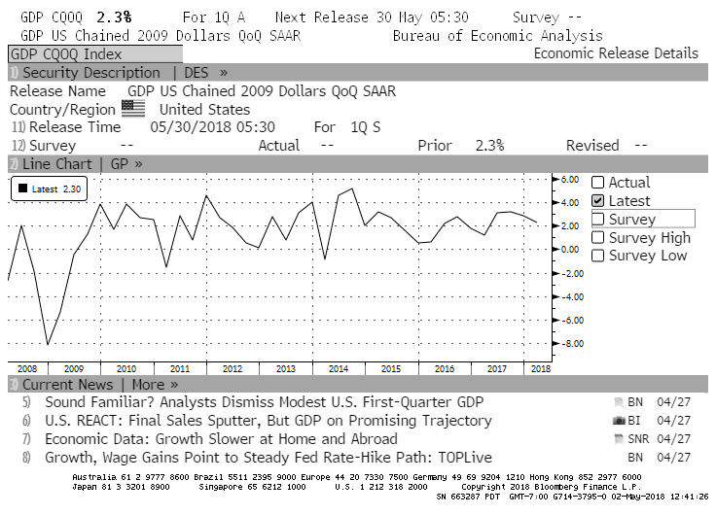

Slide 12
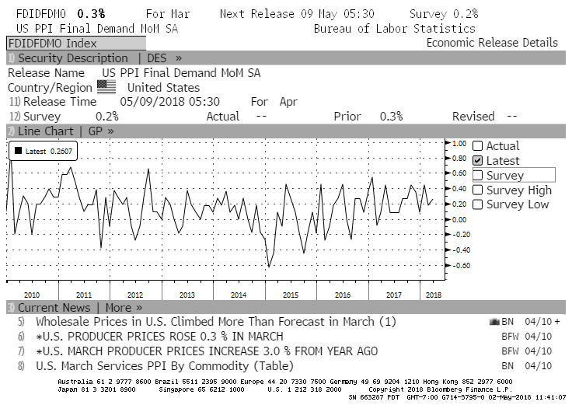

Slide 13
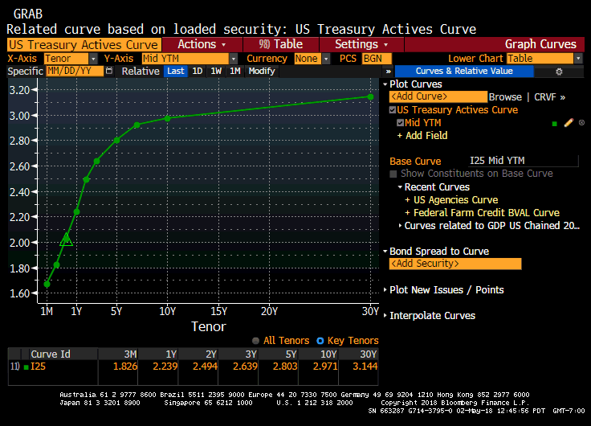

Slide 14
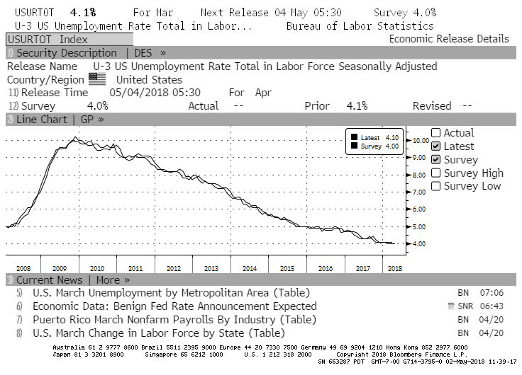

Slide 15
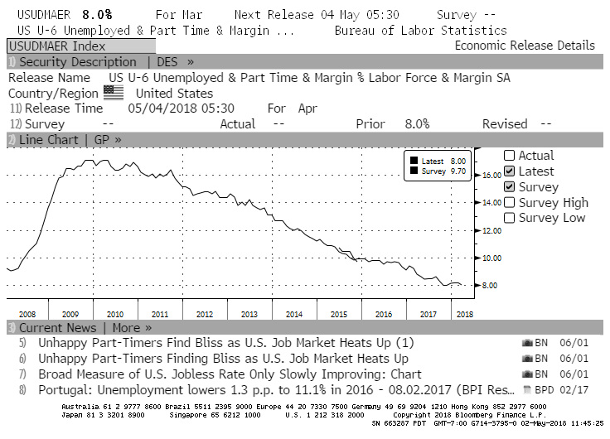

Slide 16
Progress Report and Socially Responsible Investing Discussion
Progress Report
Ad Hoc committee recommendations were implemented in the 2018 Investment Policy.
Certificate of Excellence awarded for the 2017 Investment Policy by the Association of Public Treasurers’ of the US & Canada.
Semi-annual investment review by an outside CPA firm delayed until after Q1 2018.
Selection of investment software in process. Cost is a concern of the City Manager. Budgeted at $10,000 per year starting this year. Implementation early next year.
Socially Responsible Investing
Practice
Policy change?
Thank you for your assistance in reviewing the 2018 investments held by the City of Laguna Beach!

Slide 17
Committee Consensus and Discussion
Consensus Recommendations
Exclude unrealized losses from consideration when selecting investments.
Achieving budgeted investment income is a secondary consideration when selecting securities. The adopted budget includes only realized investment income.
The Investment Policy adequately states the intended policies of Safety, Liquidity and Yield. Socially Responsible Investing is desirable but a lower priority.
Refine cash flows when possible. Continuously search of and encourage further improvement in documenting the timing of forecasted disbursements. Identify opportunities to prepare monthly cash flow estimates based on City Council approved budgets.
Discussion
When financially advantageous to the overall portfolio, make it acceptable to sell some investments, even at a loss.

